Slide 1
Tesco Finance Dashboard | Final Project
BDAT 1004 | Data Programming by Group -5

Slide 2

Our mission is to empower investors and financial enthusiasts with a comprehensive and user-friendly stocks dashboard that provides real-time data.

Slide 3




The Team
"Empowering Visionaries, Delivering Excellence."
Ashima Dhawan
Ganesh Sreeramalu Dasari
Priyanka Priyanka
Yashovardhan Pattumanchala
Business Analyst
Developer
Project Manager
Data Analyst

Slide 4
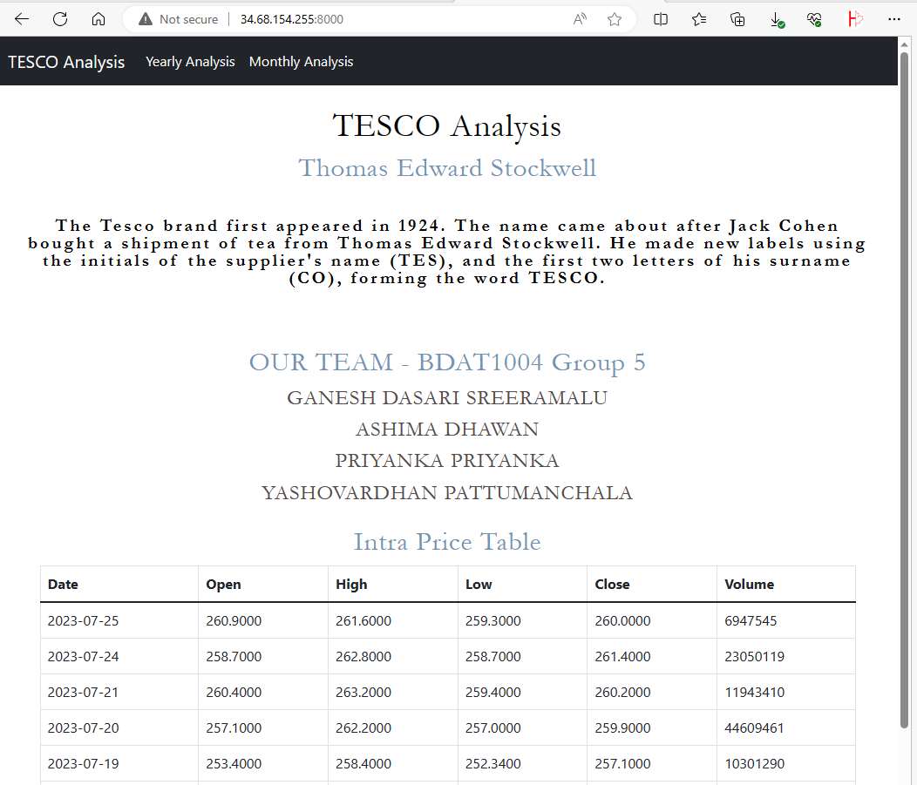
The Project
Our Intraday Stocks Price Tracker is a result of dedication, expertise, and passion for providing users with an efficient and reliable tool to navigate the complex world of stocks. By combining Python's programming prowess, MongoDB's data management capabilities, Flask's backend efficiency, and JSON Charts' visualization prowess, we have created a platform that empowers investors with valuable market information.
Key Features:
Intraday Stock Prices: Our website offers real-time updates on stock prices, allowing users to stay on top of market fluctuations throughout the trading day.
Highs and Lows: Users can easily access the intra day price table that showcase the highest and lowest stock prices, enabling them to identify potential opportunities and risks.
Best Performing months & years: The platform highlights the best-performing time of Tesco stock adding more value for the investors.
Seamless Deployment on Google Cloud Platform(GCP): We deployed our website using GCP, a cloud-based web hosting service, ensuring uninterrupted access and smooth user experiences.

Slide 5
Website Development life Cycle
Step 3
Step 2
Step 1
Step 4
Deployment
Design Phase
Development Phase
Requirement phase :

Slide 6
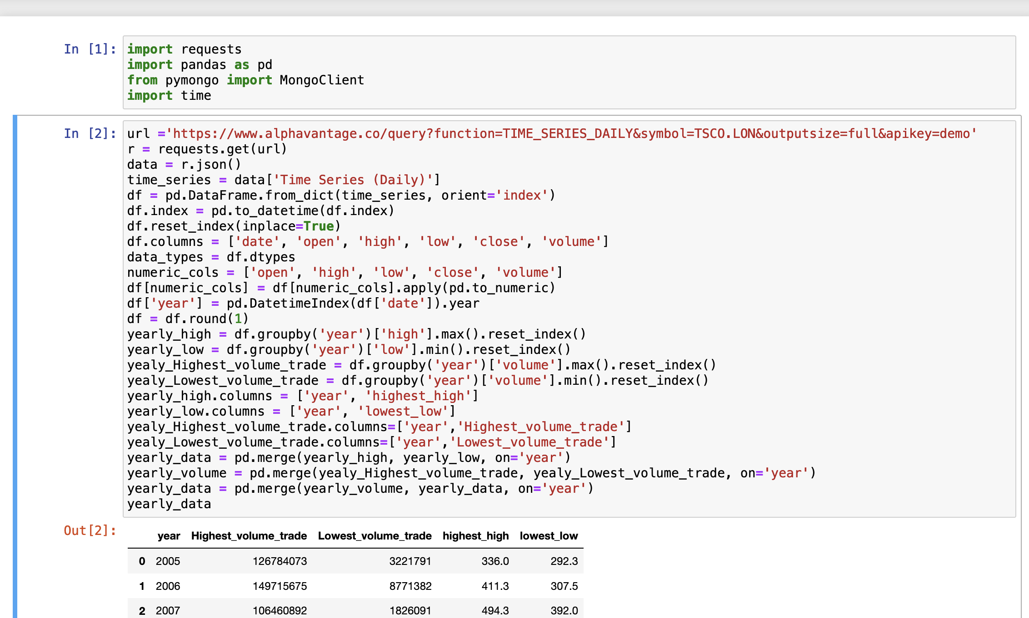
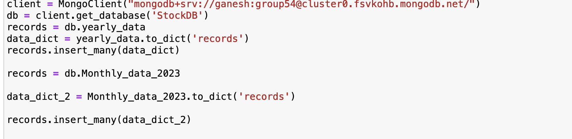
Requirement Gathering
Fetching data from Alphavantage API. We successfully pulled the TESCO Intra day time series data
Data cleaning using Pandas library
Loading data to Mongo DB

Slide 7
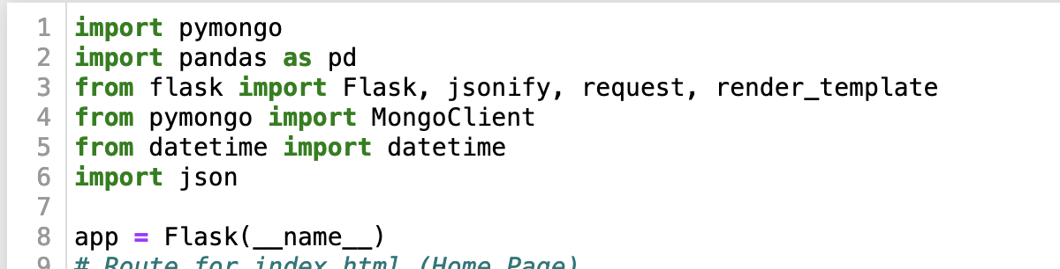
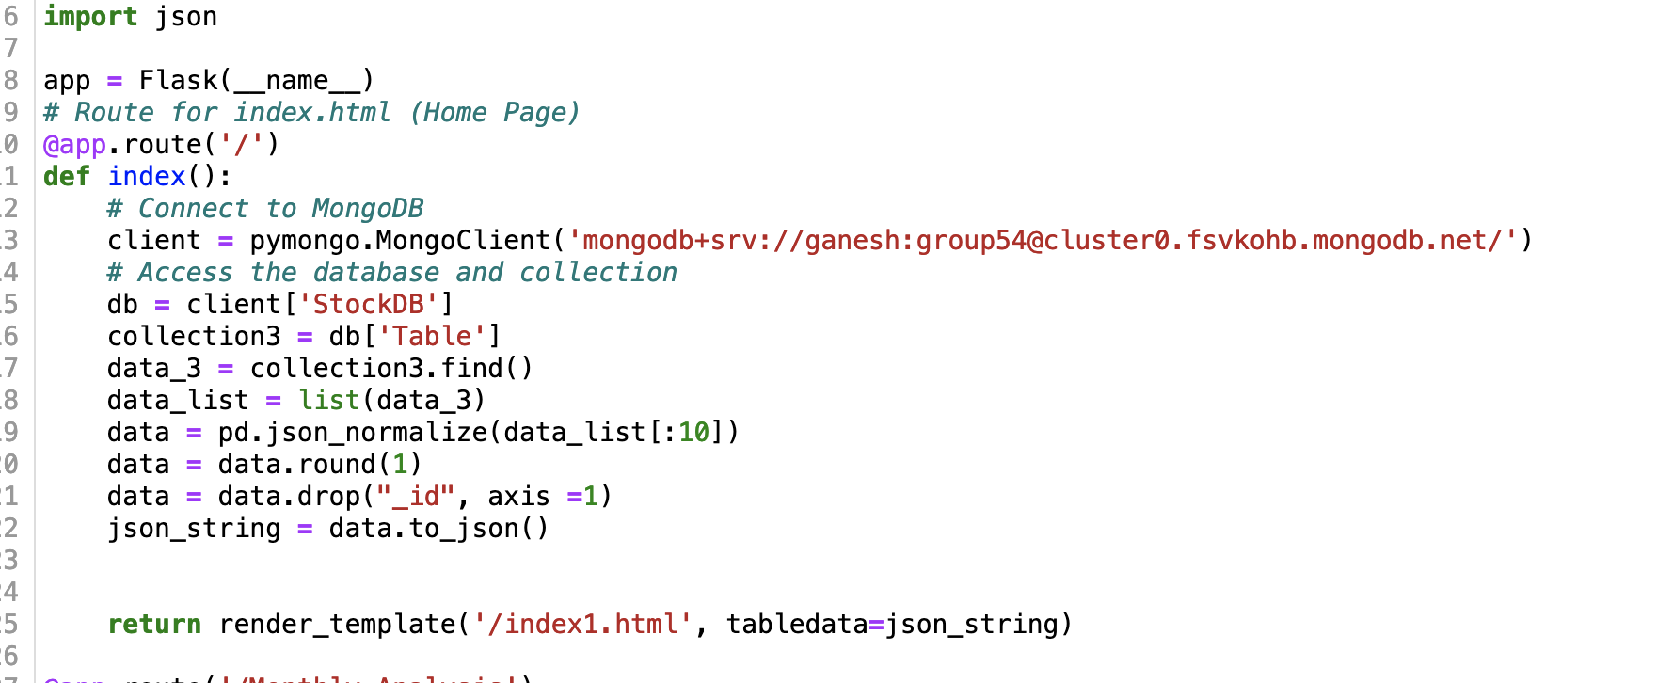
Development
Setting up python libraries for our backend
Fetched data from DB for intra day table

Slide 8
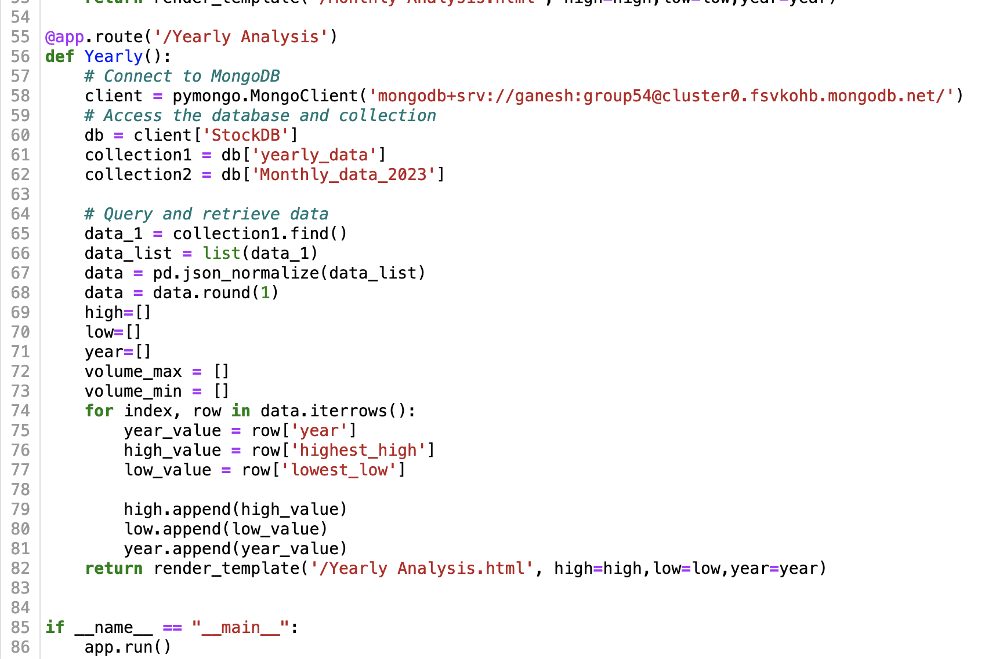
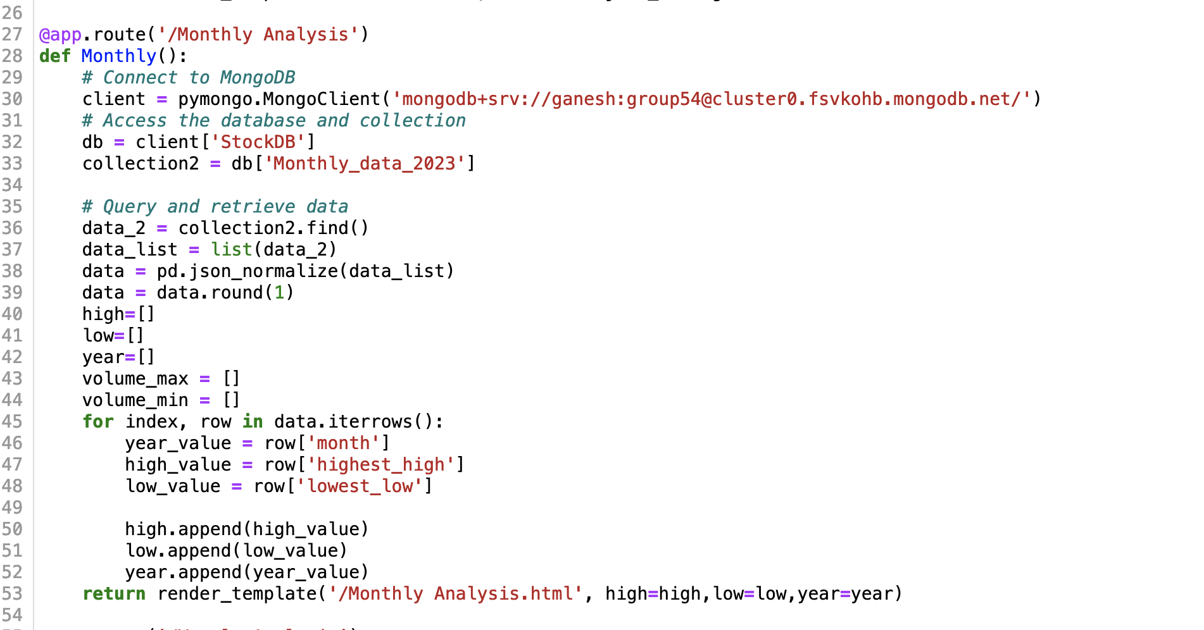
Development
Monthly Analysis data
Yearly Analysis data

Slide 9
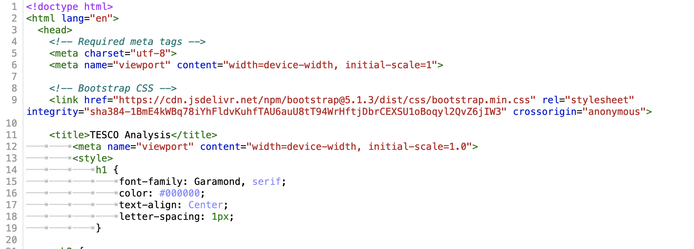
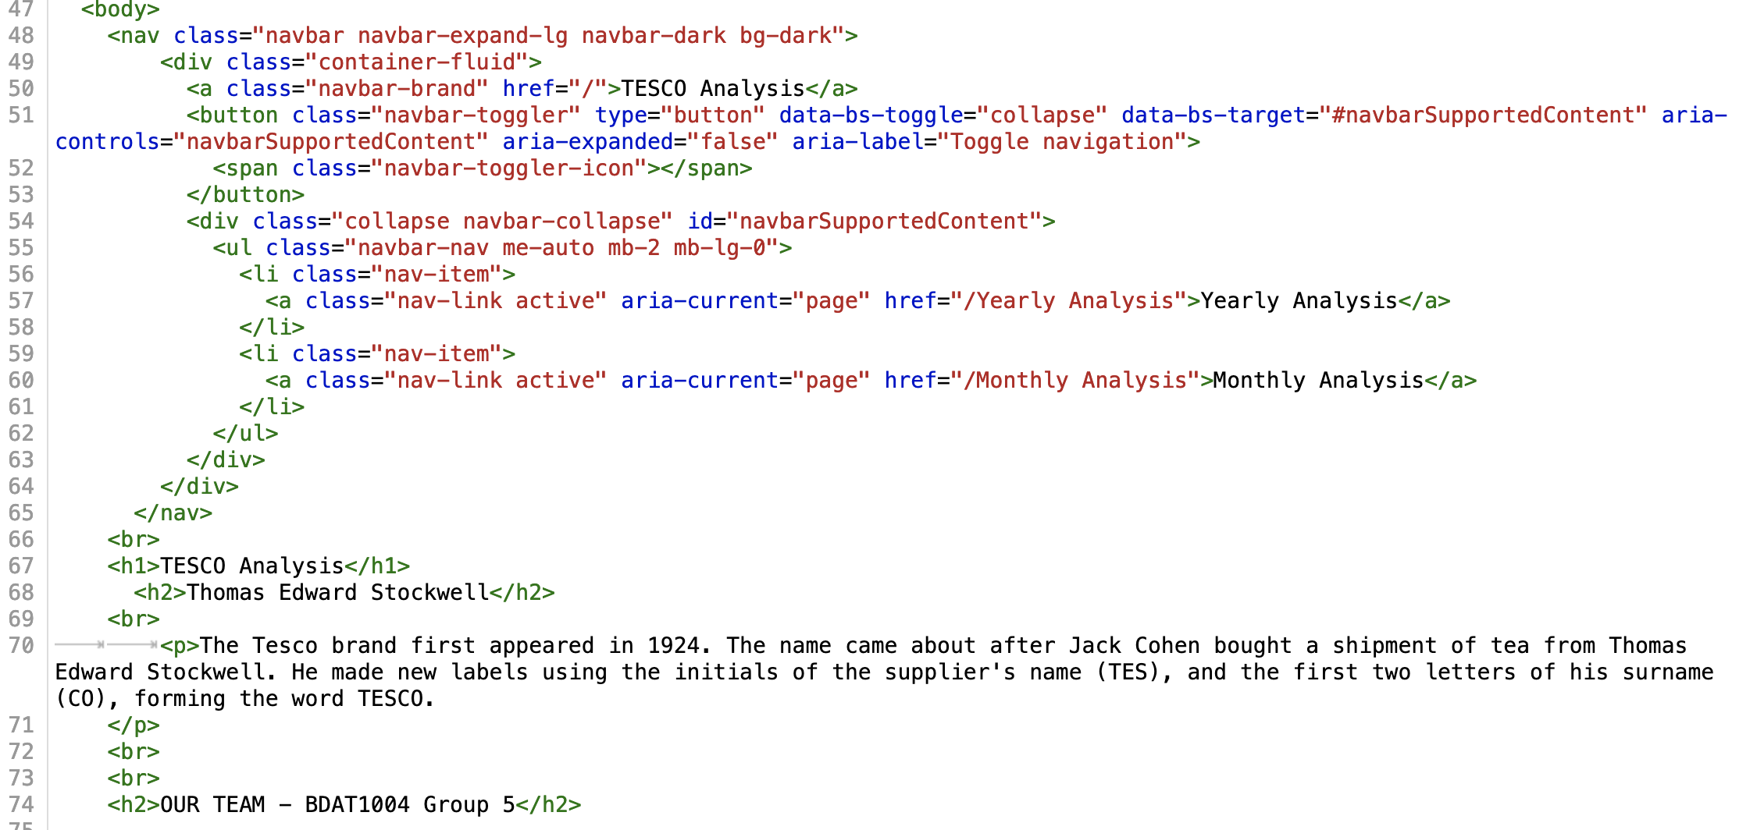
Our Design Journey
Our creative team designed an intuitive interface for a delightful user experience.
Using HTML script, we plotted JSON charts
Created a navigation bar using Bootstrap

Slide 10
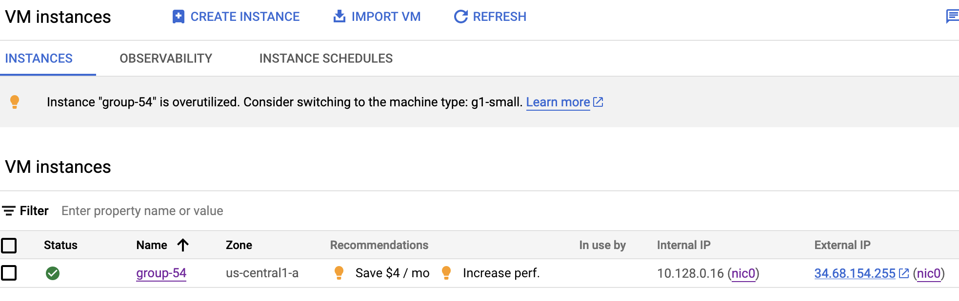
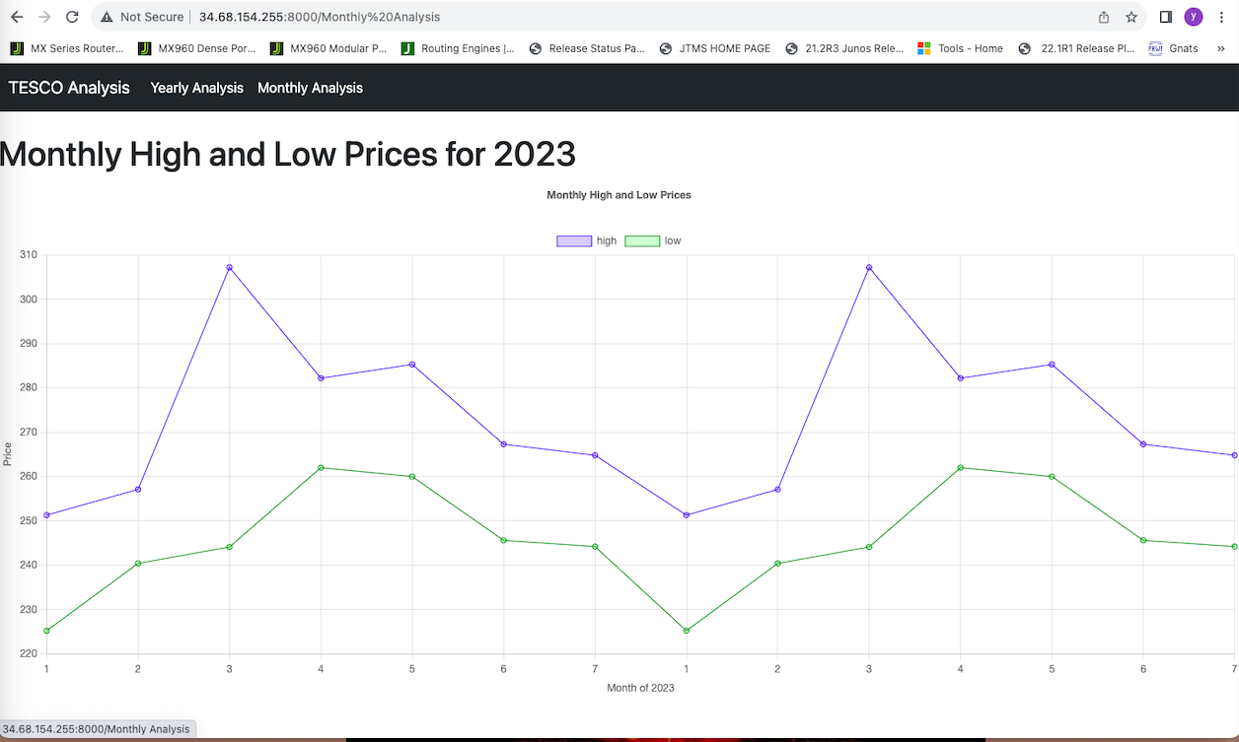
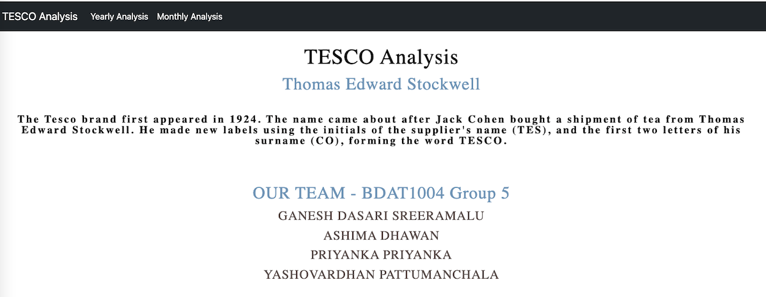
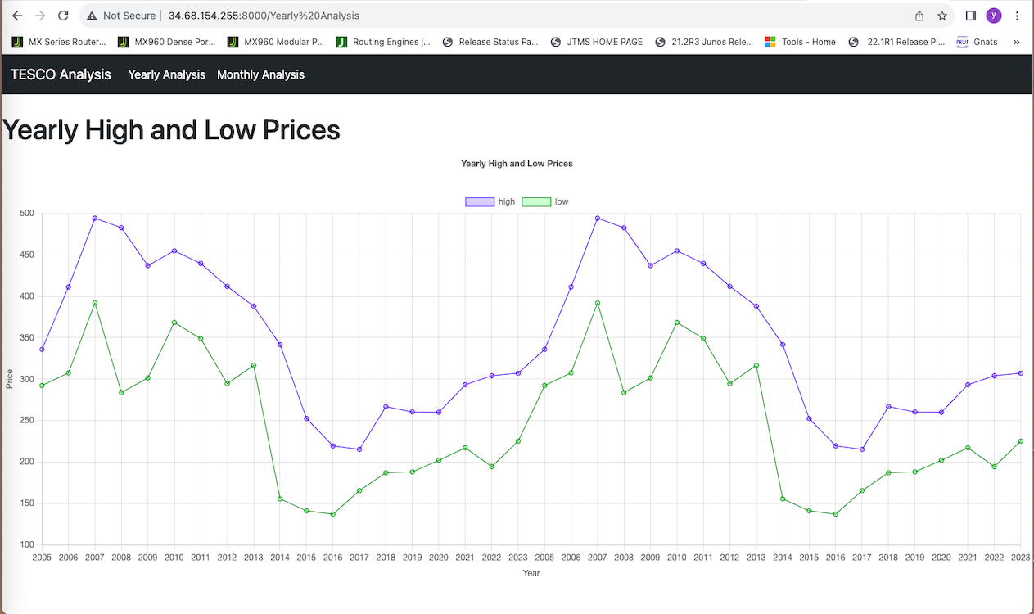
Deployment
Seamless deployed via Google cloud platform

Slide 11

The solution
Our intuitive stocks dashboard
URL - http://34.68.154.255:8000/
GitHub Repo - https://github.com/Ashima-GC/bdat-1004-dpfp/tree/main

Slide 12
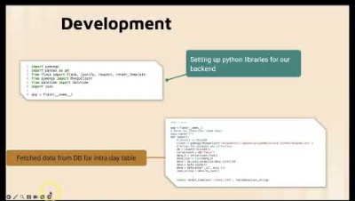
YouTube Link

Slide 13
Questions?

Slide 14


Thank you !

